Slide 1
USSD SETUP

Slide 2
USSD SETUP

Slide 3
Scope
implementation of an interactive Unstructured Supplementary Service Data (USSD) service for GSM mobile users.
An overview of the network architecture and a description of interactive USSD
Sample code also shows an application that can be developed

Slide 4
Architecture

Slide 5
Introduction
Unstructured Supplementary Service Data (USSD) is a capability built into GSM phones, much like the Short Message Service (SMS).
USSD differs from SMS as follows:
SMS uses a “store and forward” technique to deliver text messages:
A text message is first sent to a sender’s Short Message Service Center (SMSC) before the SMSC tries to deliver the text message to the recipient. The sender receives an indication of whether the text was successfully received by the SMSC; however, the text message is not guaranteed to reach the recipient instantly.

Slide 6
Introduction
USSD differs from SMS as follows:
USSD information is sent directly from a sender’s mobile handset to an application platform handling the USSD service. The USSD service can be located either in the sender’s mobile network or in a visited mobile network.
A real-time “session” is initiated between the mobile user and the USSD application platform when the service is invoked, allowing data to be sent back and forth between the mobile user and the USSD application platform until the USSD service is completed.

Slide 7
Example Menu-Driven USSD Application
“Balance Enquiry and Top Up” application using USSD signaling
A mobile user initiates the “Balance Enquiry and Top Up” service by dialing the USSD string defined by the service provider; for example, *#123#.
The USSD application receives the service request from the user and responds by sending the user a menu of options.
The user responds by selecting a “current balance” option.
The USSD application sends back details of the mobile user’s current account balance and also gives the option to top up the balance.
The user selects to top up his/her account.

Slide 8
Example Menu-Driven USSD Application
The application responds by asking how much credit to add?
The mobile user responds with the amount to add.
The USSD application responds by sending an updated balance and ends the session.
NB: TCAP: Transaction Capabilities Applications Part

Slide 11
How to Format USSD Text
In the “Balance and Top Up” service example, the network USSD application responds to inputs from the mobile user with various menus and questions.

Slide 12
How Is Menu Information Sent to the User?
The menu, as it appears on the screen of the mobile handset, is actually a straightforward text string broken up using carriage return <CR> characters
The text string:
Welcome to XYZ Telecom<CR>Press:<CR>1. Balance Notification <CR>2. Top Up Service
Will be presented on the handset as ...

Slide 13
TECHNICAL SETUP REQUIREMENTS
The following are reuired processes in the setting up a successful USSD service with an MNO. Some of the stated processes are specific to individual MNO’s.
IP whitelisting (All MNOs): it is required the CP provides an IP which will be responsible for handling communications with the MNOs for whitelisting by the MNO.
PORT OPENING (All MNOs): it is also required required for CPs to provide an HTTP port for configuration on the MNOs’ firewall. This port will be the only port through which communication will be allowed.
VPN connection (Vodafone): Vodafone requires the creation of a site-to-site VPN tunnel to enable communication between them and the CP.

Slide 14
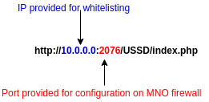
TECHNICAL SETUP REQUIREMENTS
System Identification service activation (MTN): MTN requires CPs to run a system identification and registration service script to enable them register the CPs system before communication is allowed.
Security key installation (TIGO): Tigo provides CPs with a security key file which is to be installed on the server to handle the communication.
API Provision (All networks): CP’s are required to provide APIs to which the MNO can forward all USSD requests to. The API must be on the IP provided for whitelisting and port provided.

Slide 15
USSD REQUESTS
Once a user dials and sends a ussd request eg. *899# the MNO pushes the request to the CP’s provided API.
It is key to note that all operator request and expected response formats are different and must be considered in the develpment of a CPs API script.

Slide 16
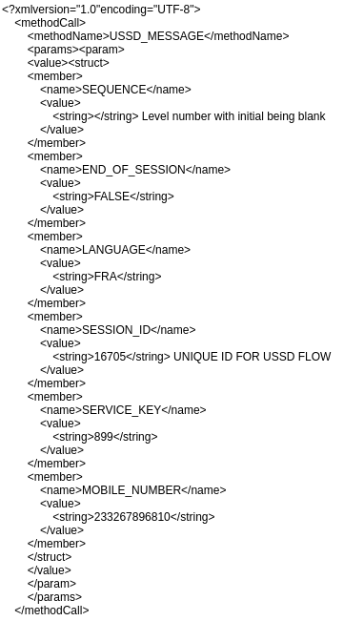
AIRTEL
REQUEST
FORMAT: XML

Slide 17
AIRTEL
Response
FORMAT: XML
<methodResponse><params><param><value><struct><member><name>RESPONSE_CODE</name><value><string>0</string></value></member><member><name>SESSION_ID</name><value><string>".$Session_ID."</string></value></member><member><name>SEQUENCE</name><value><string>1</string></value></member><member><name>USSD_BODY</name><value><string>".$reply."</string></value></member><member><name>REQUEST_TYPE</name><value><string>RESPONSE</string></value></member><member><name>END_OF_SESSION</name><value><string>".$type."</string></value></member></struct></value></param></params></methodResponse>
$Session_ID: this is a unique identification of the user’s session
$reply: this is the exact response to be shown on the users phone.
$type: this indicates whether the session should be terminated or continue. Required values are TRUE – to terminate session and FALSE – to continue the session.

Slide 18
MTN
The request is received in a string format with each parameter separated by | . To get the parameters the below php code is used: 10101 is the sequence ID, 899 is the request the user dials, GW and Menu constant
REQUEST
FORMAT: HTTP Post request
http://10.0.0.0:2076/?msisdn=233241477600&message=10101|*899#|GW|MENU
<?php
$msisdn = "";
$data = "";
$request = $_GET['message'];
$msisdn = $_GET['msisdn'];
$reqArr = explode("|", $request);
$sequence_ID = $reqArr[0];
$data = $reqArr[1];
$gtw = $reqArr[3];
$menu = $reqArr[2];
?>

Slide 19
MTN
Response to MNO
Format: HTTP print response
Example: echo $sequence_ID . "|" . $type . "|" . $reply . "|" . $menu . "|" . $gtw;
$Session_ID: this is a unique identification of the user’s session
$reply: this is the exact response to be shown on the users phone. (E.g Welcome Menu)
$type: this indicates whether the session should be terminated or continue. Required values are 1 – to terminate session and 0 – to continue the session.

Slide 20
Vodafone
REQUEST:
Format: HTTP Post
Example: http://example.com/?msisdn=233502982300&sessionid=1304365832&type=0&msg=*899*

Slide 21
VODAFONE
Response
FORMAT: XML
Example:
<ussd>
<type>".$type."</type>
<msg>".$reply."</msg>
<premium>
<cost>0</cost>
<ref>".$sequence_ID."</ref>
</premium>
</ussd>
$Session_ID: this is a unique identification of the user’s session
$reply: this is the exact response to be shown on the users phone.
$type: this indicates whether the session should be terminated or continue. Required values are 1 – to terminate session and 0 – to continue the session.

Slide 22
TIGO
REQUEST
FORMAT: HTTP Post request
http://example.com/?msisdn=233241477600&userinput=2&session=1010101&requestId=1234
Userinput is the data the user dials and submit
Session is the unique ID the MNO assigns to every transaction
requestID is an ID assigned to each request example levels.

Slide 23
TIGO
Response
Format: HTTP print response
Example: echo $sequence_ID . "|" . $type . "|" . $reply ;
$Session_ID: this is a unique identification of the user’s session
$reply: this is the exact response to be shown on the users phone.
$type: this indicates whether the session should be terminated or continue. Required values are 1 – to terminate session and 0 – to continue the session.

Slide 24
Service development and session management
The first step in the development of a USSD service is to document a logical flow for your service.
Example (for a voting USSD service):
User dials code (*899#)
Welcome to Ashesi voting (Case 1)
1. Select candidate (Case 1)
1. James Quist (Case 2)
2. Jean Jess (Case 2)
3. Charles Thompson (Case 2)
Thank you for voting (Case 3)
0. Exit (Case 1)
Cases is a way a CP can identify the stage at which a user is within a transaction in order to know which options to feedback to the user.
In order to effectively manage a users stage progression a CP can employ a system which stores each request from a user in a database table to aid in easily identifying which case a user got to in his previous request. A sample table structure can be shown below;
This keeps record of the users phone number, transaction being performed and
current case details labeled as Tx ,Considering a service flow with a maximum of 8 cases
Notes:
1. Check which level

Slide 25
TO BE CONTINUED ON THURSDAY

